Slide 1
Remote Sensing Object Detection
CivilEn 7421 Group Project
Hanlei Gu, Yuvraj Singh, Zhizhong Ma, Alexys R Avellaneda

Slide 2
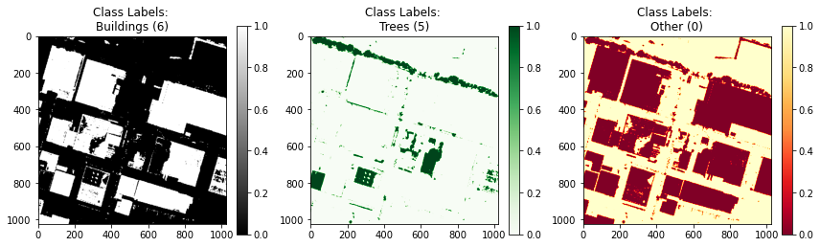
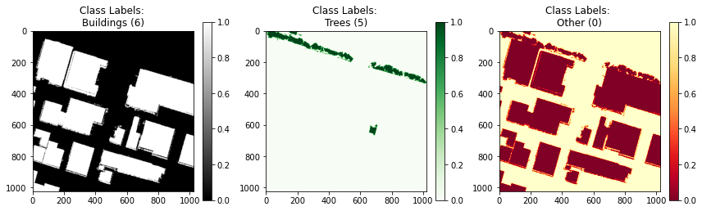
In-Class Test Results
Classifier
Predictions
Ground Truth

Slide 3
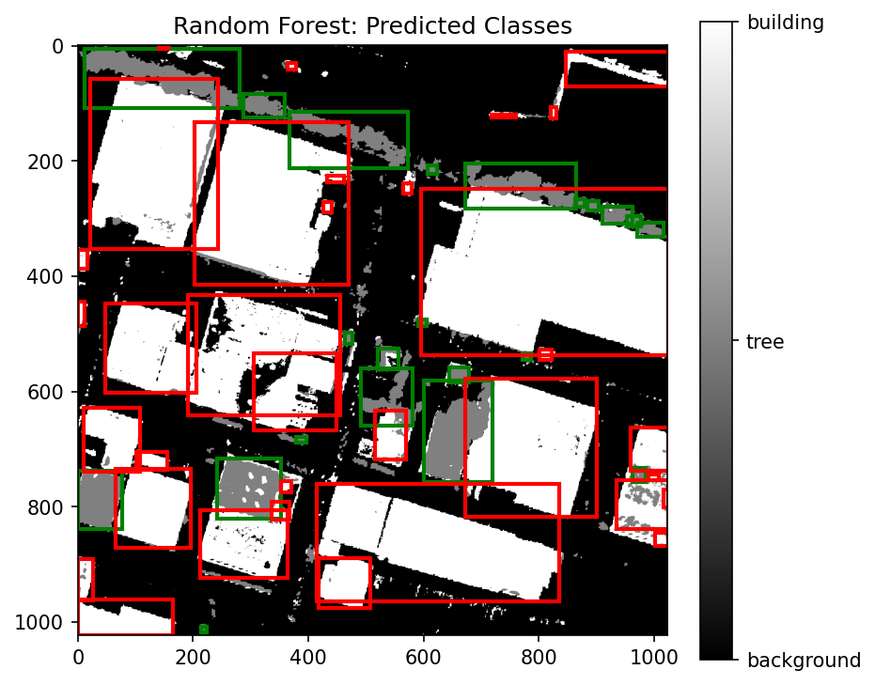
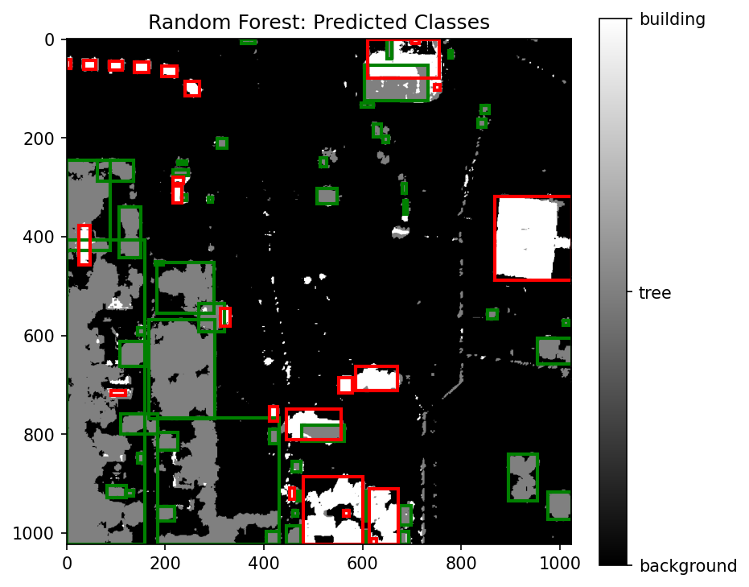
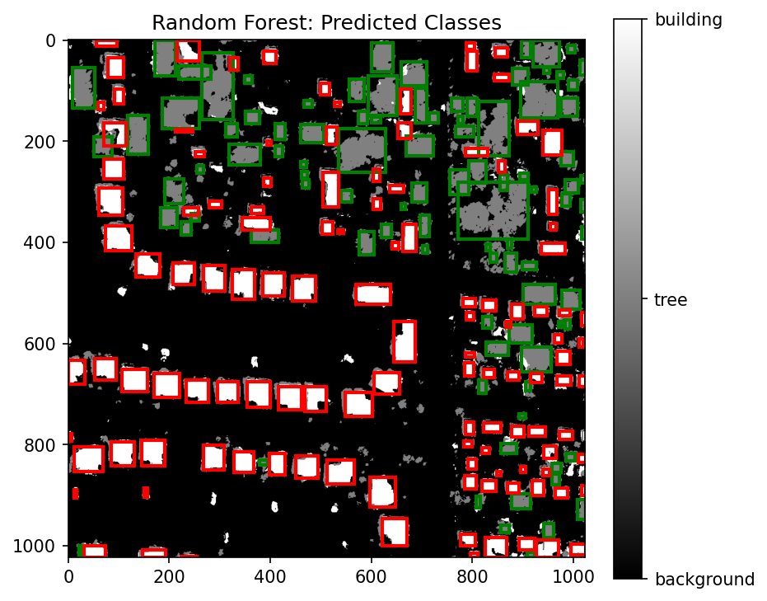
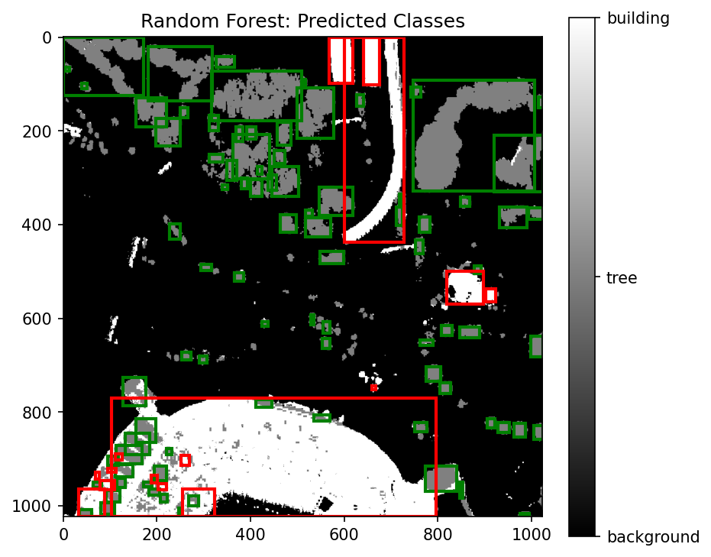
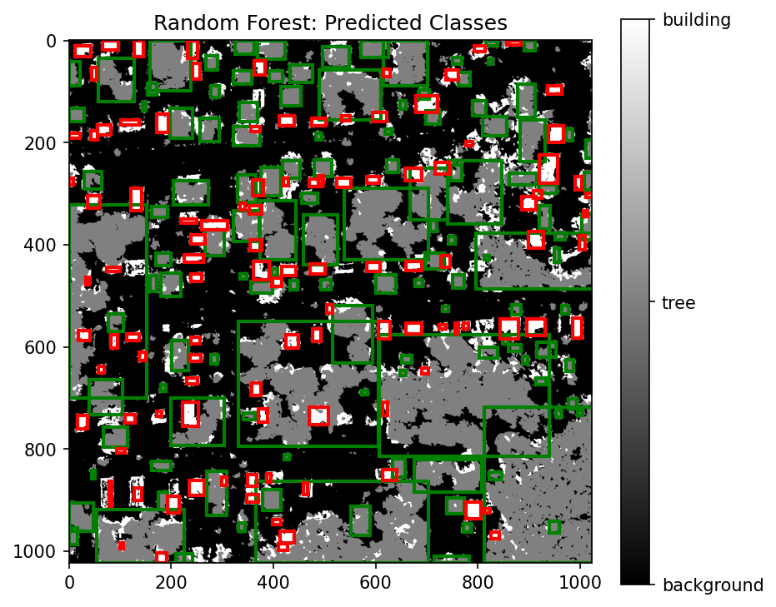
In-Class Testing: Bounding Boxes

Slide 4
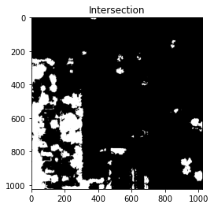
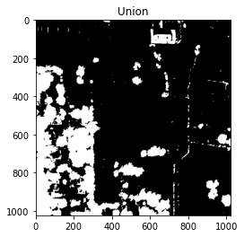
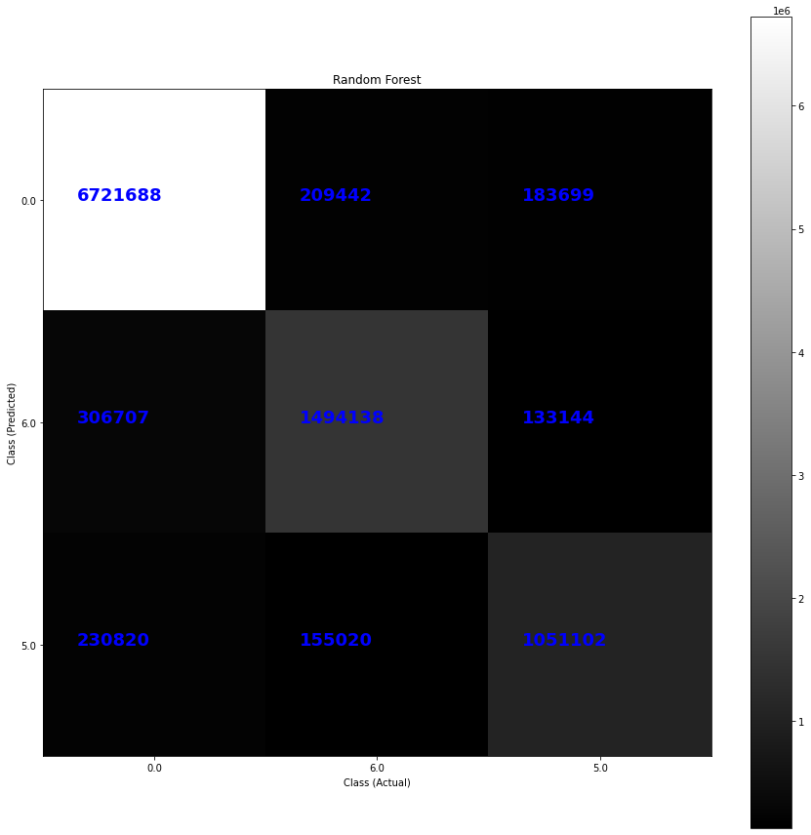
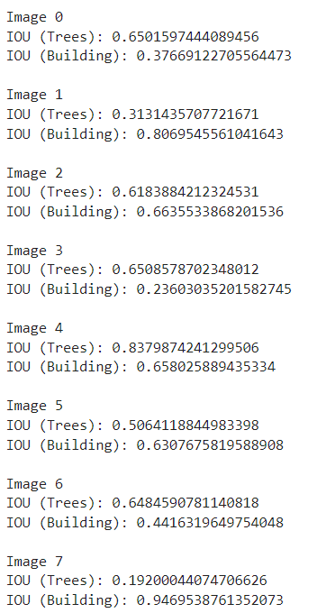
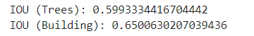
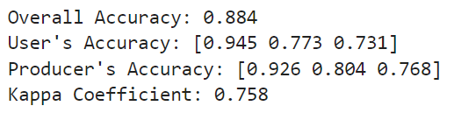
In-Class Testing: Metrics
IOU for individual testing images
IOU for all testing images
Classifier overall accuracy: 0.884
Kappa Coefficient: 0.758

Slide 5
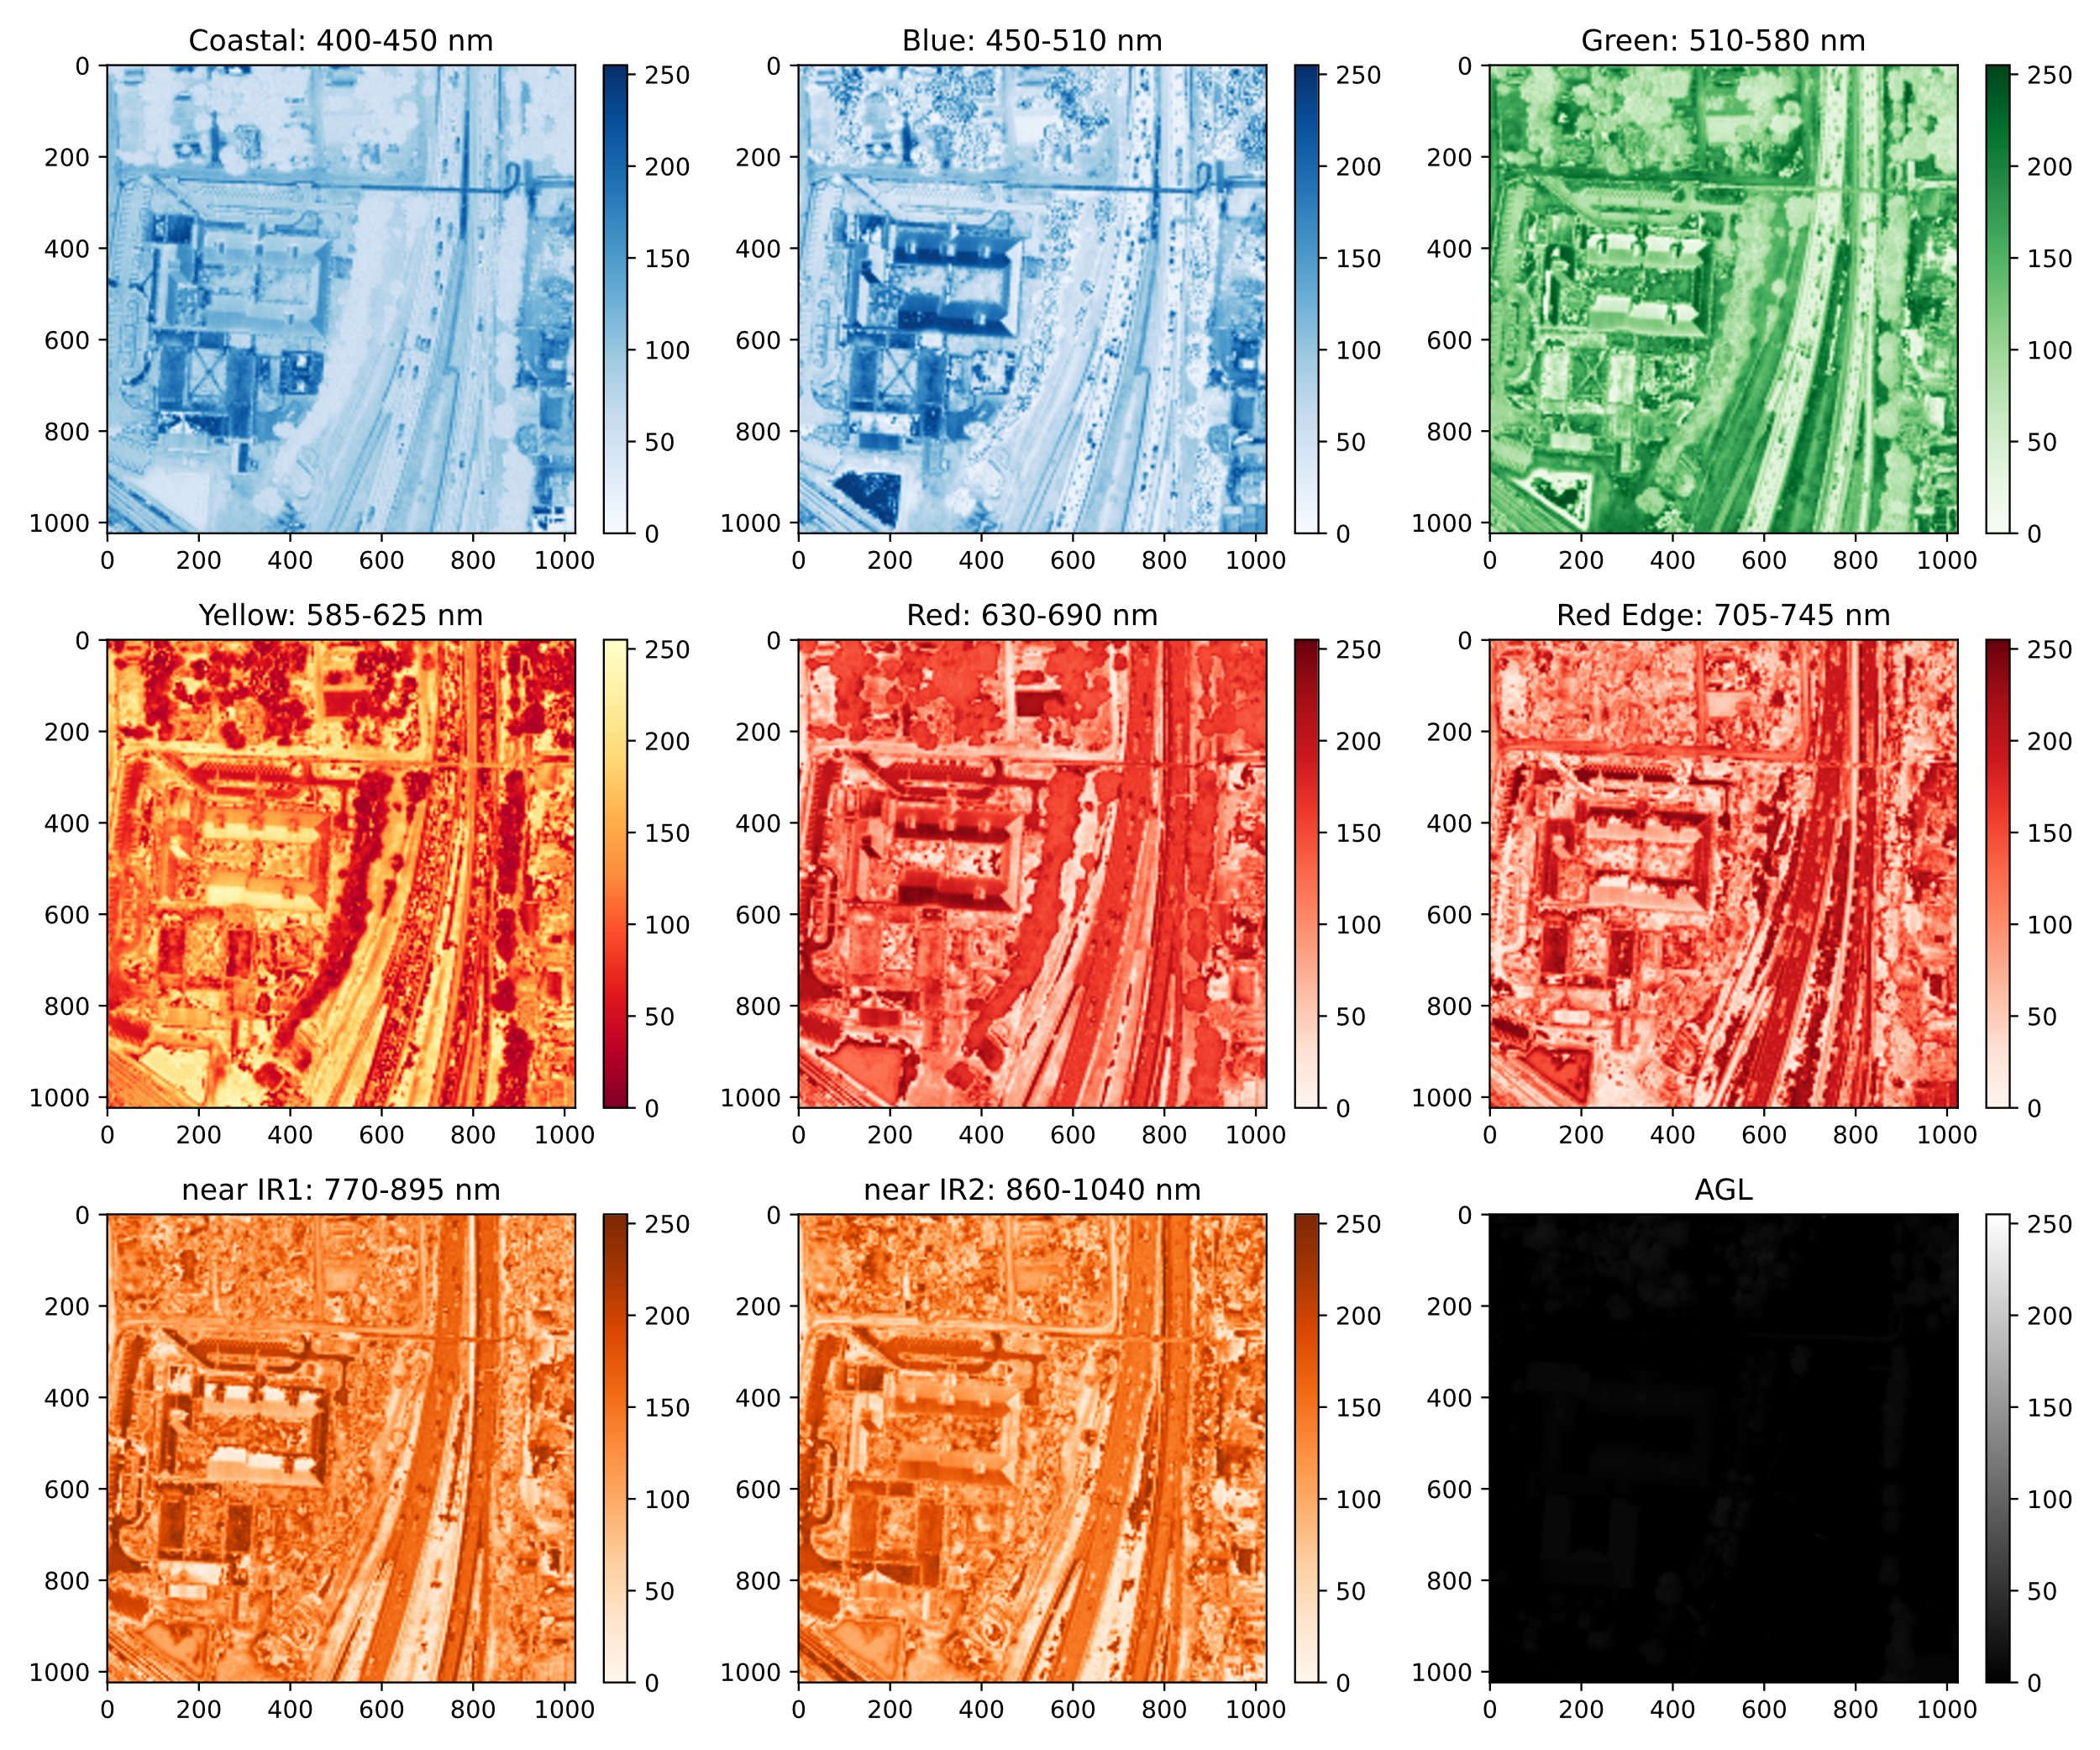
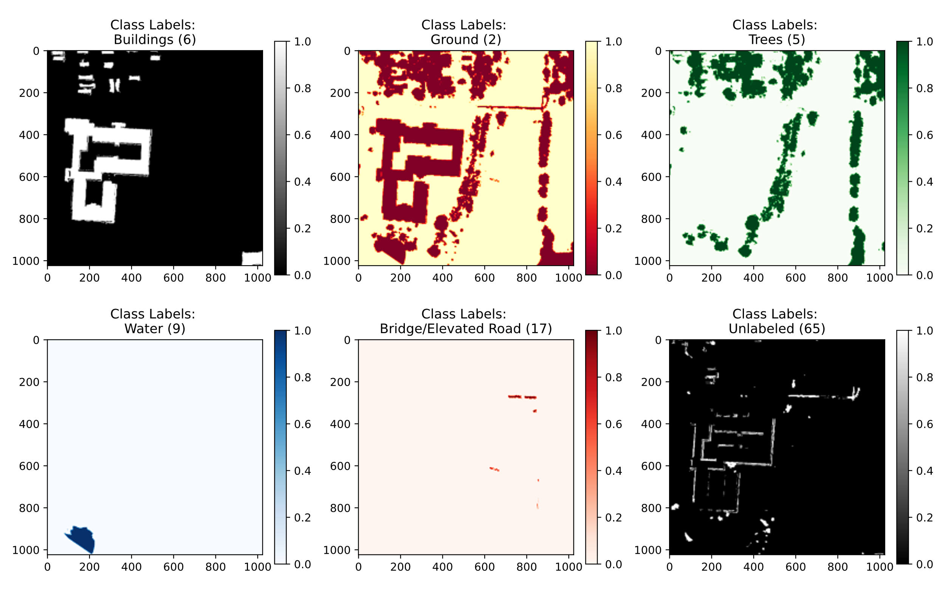
Dataset: Raw Data
Raw Data: Predictors
Ground Truth Targets

Slide 6
Types of Features
Principal Component Analysis
First 3 components
Morphology
Erosion
Dilation
Opening
Closing
Independent Component Analysis
First 3 components
GLCM
Contrast
Dissimilarity
Homogeneity
Energy
Correlation
Orpheo Toolbox Features
https://www.orfeo-toolbox.org/
+64

Slide 7
Feature Selection
https://scikit-learn.org/
Low Variance
Variance Threshold
Univariate Selection
K Best
Percentile
Test
Chi2
Mutual Information
Recursive Elimination
RFE with cross validation
Select from Model
Feature Importance
Tree-Based
Sequential Selection
Pipeline Option

Slide 8
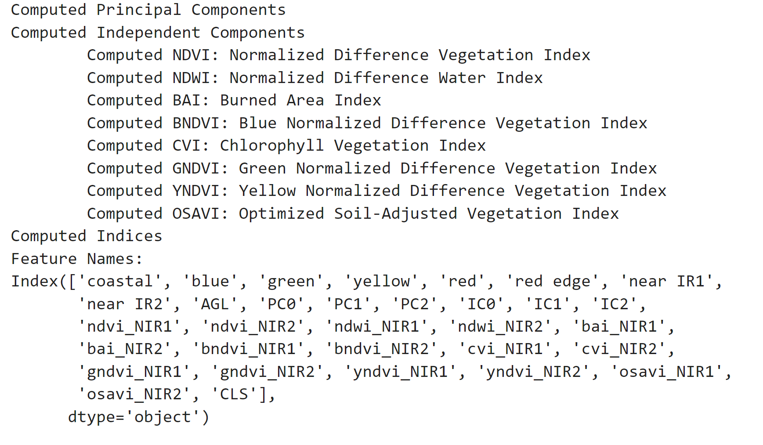
Features Selected

Slide 9
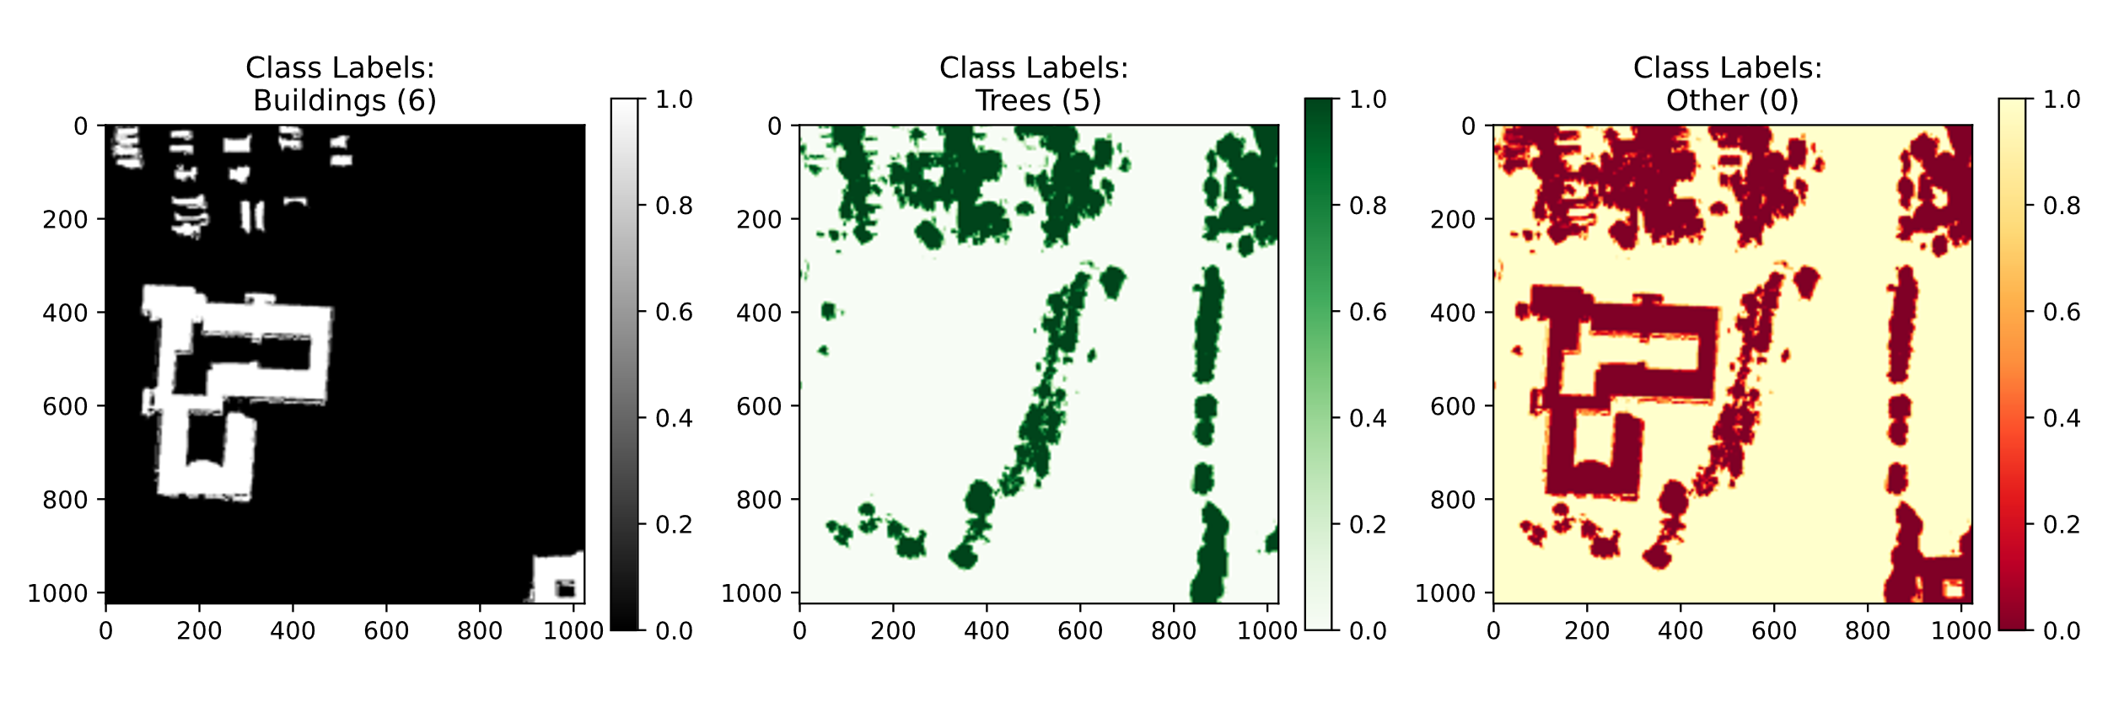
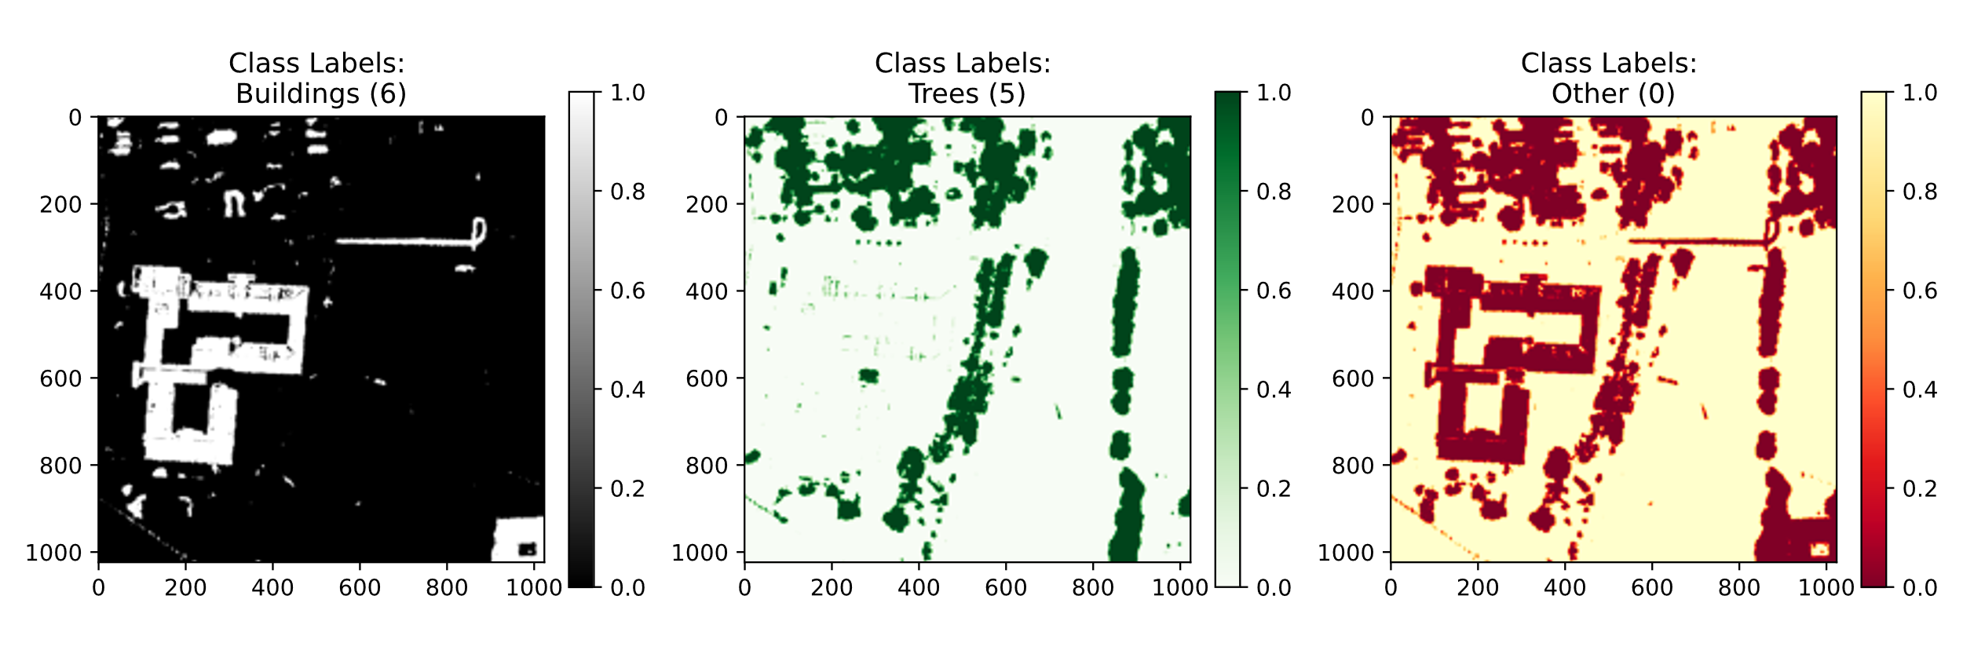
Random Forest: Results on Validation Set
Ground Truth
Predicted

Slide 10
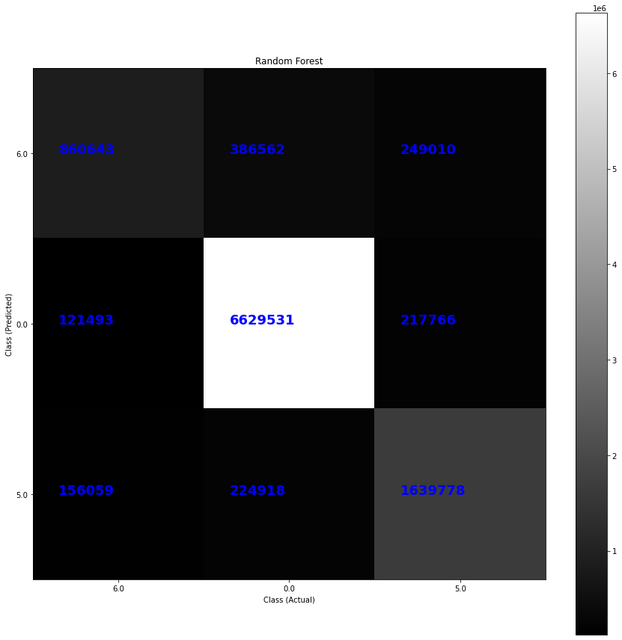
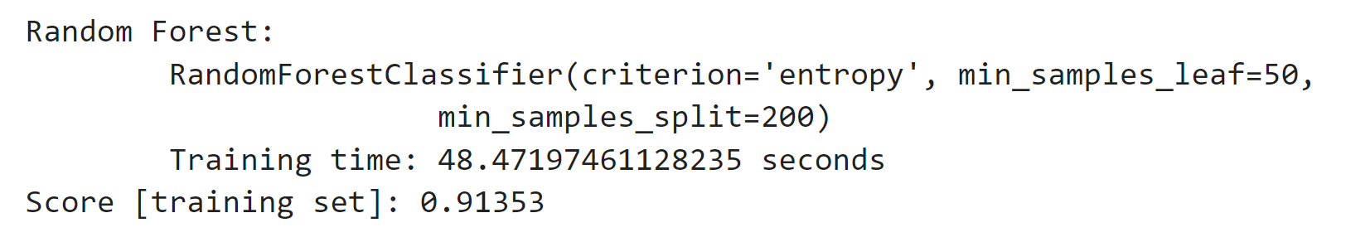
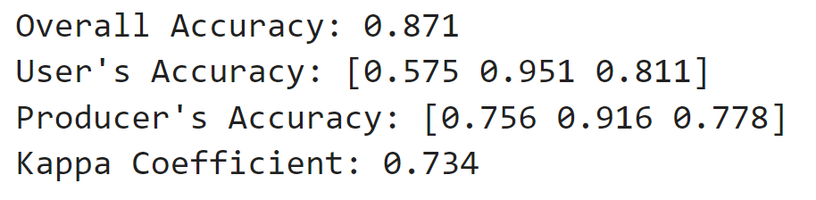
Random Forest: Confusion Matrix
Validation Set Performance:

Slide 11
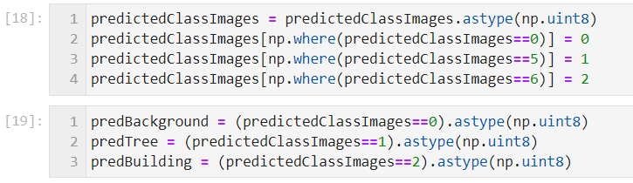
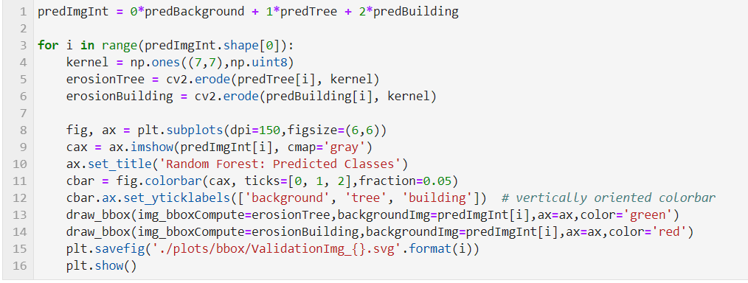
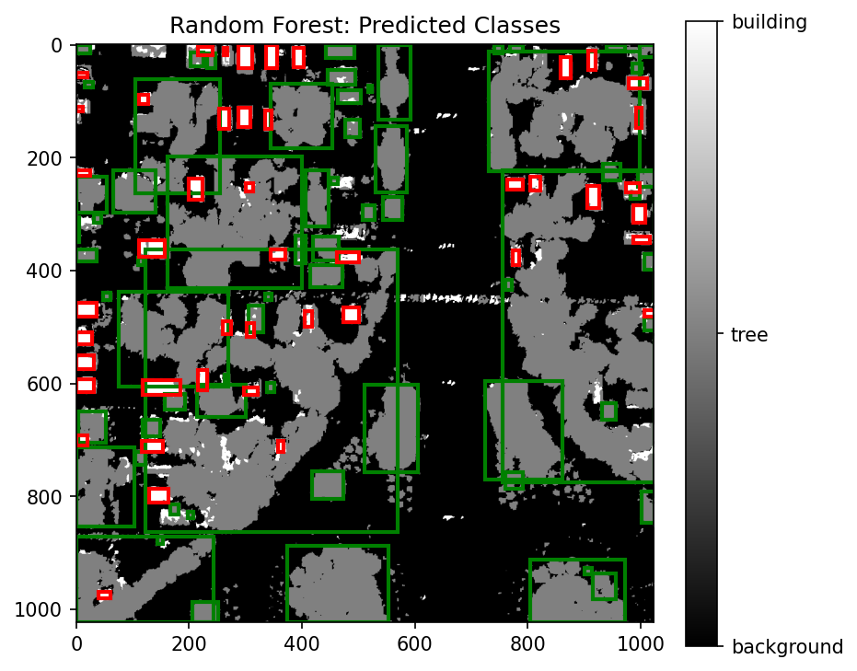
Bounding Box: Procedure
Constructed Binary Images for each class prediction
Compute erosion of each class prediction binary image. Draw bounding Box over it

Slide 12
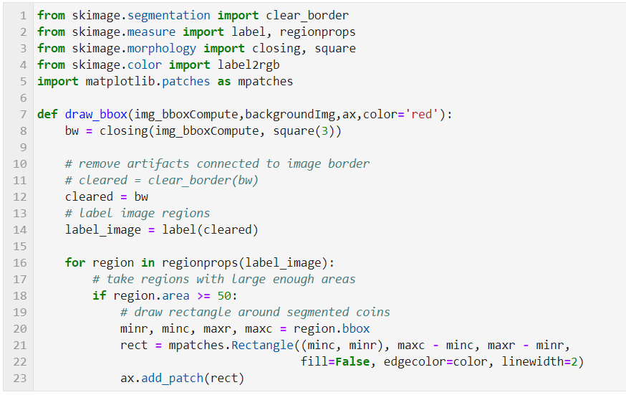
Function to plot bounding boxes

Slide 13
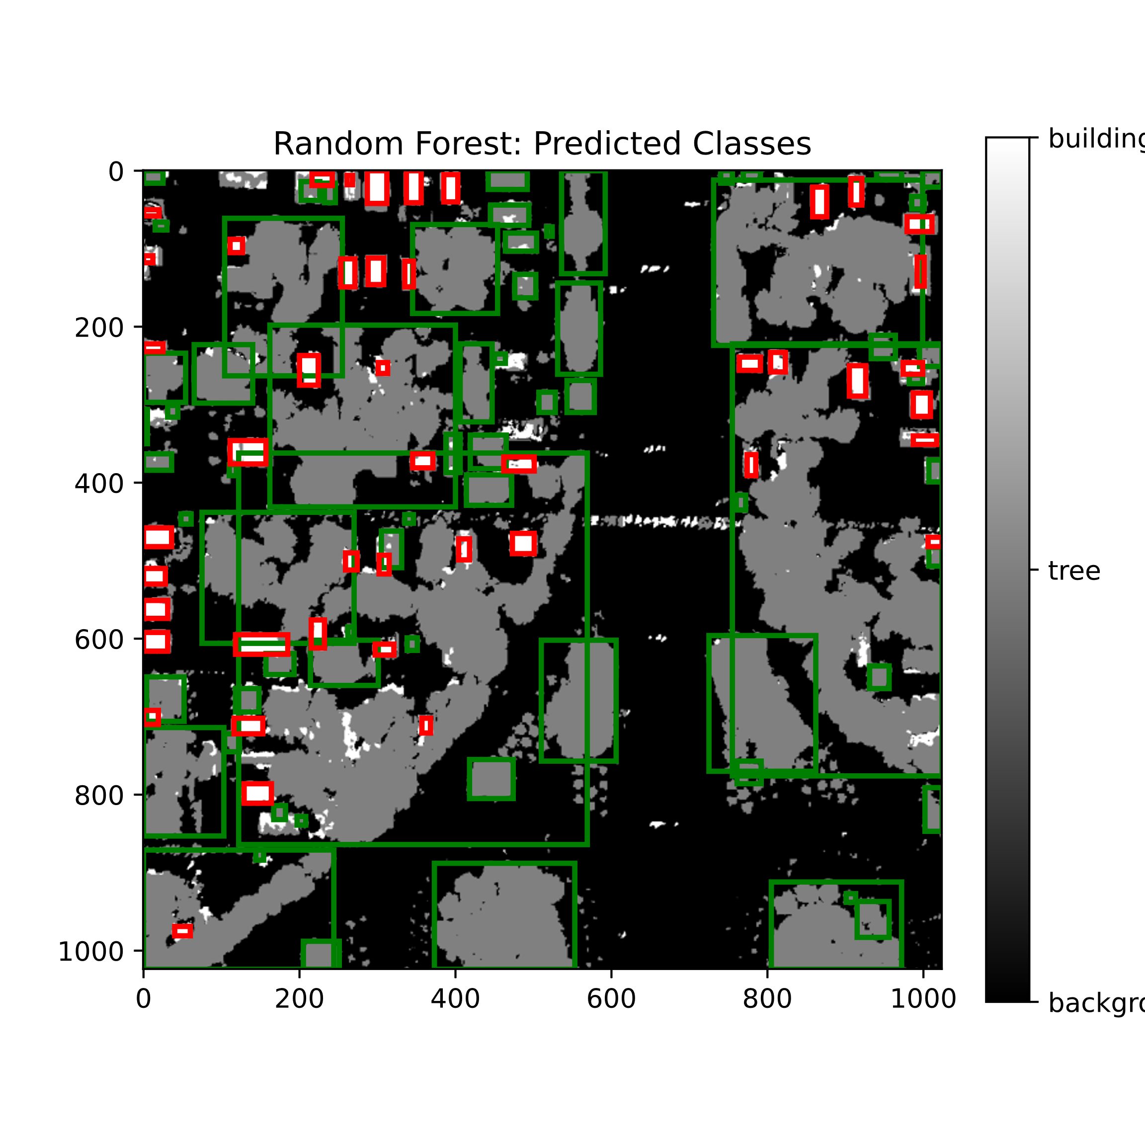
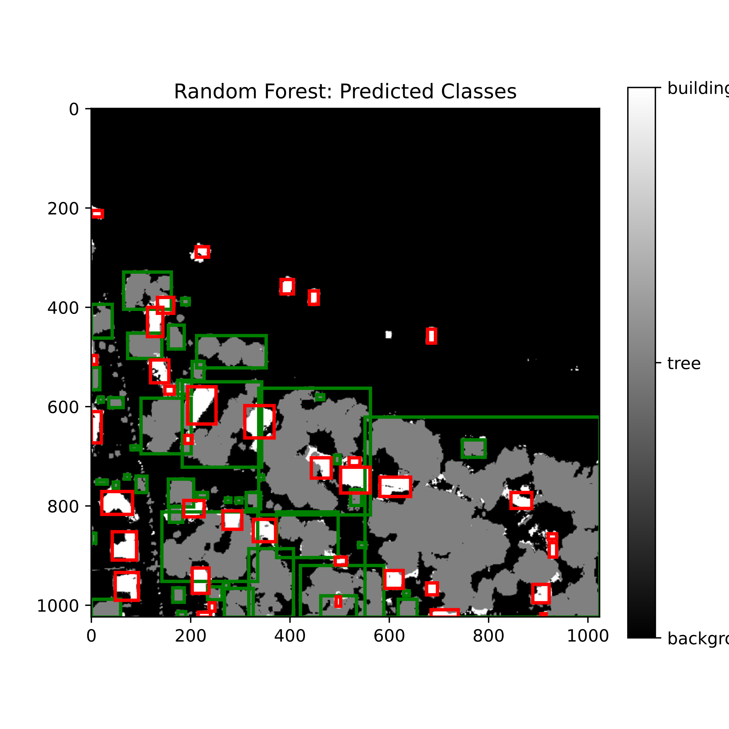
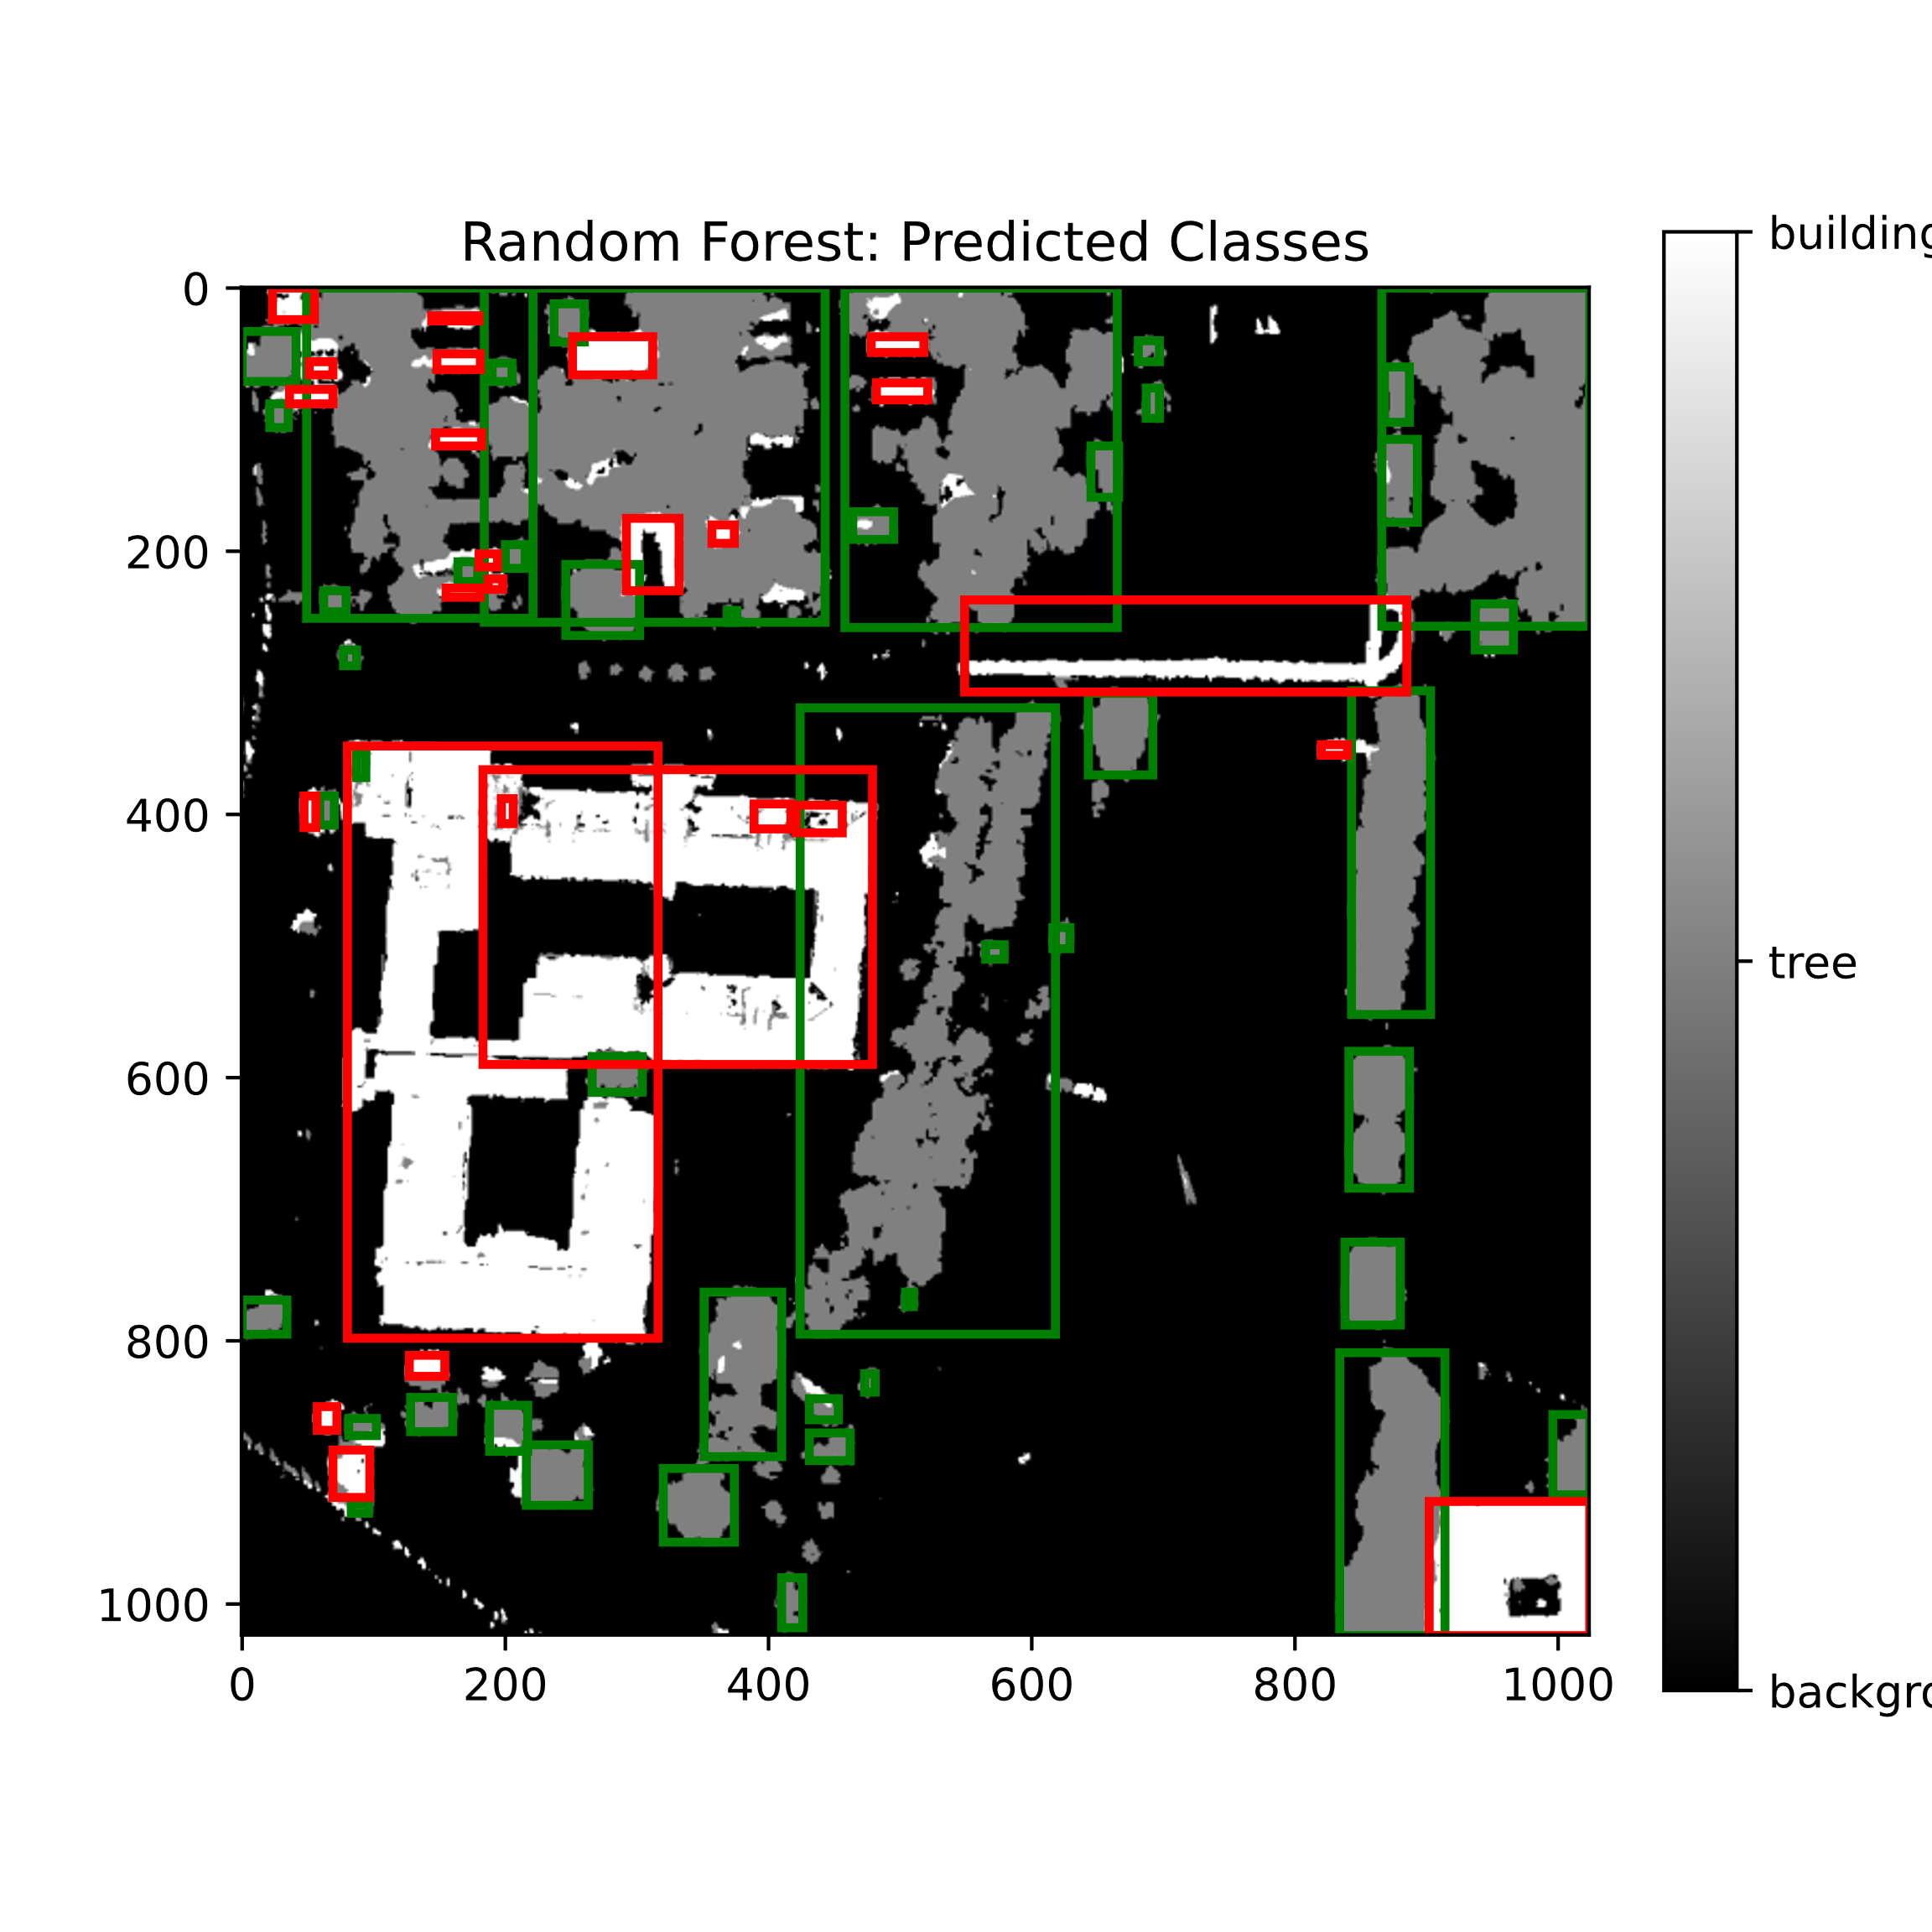
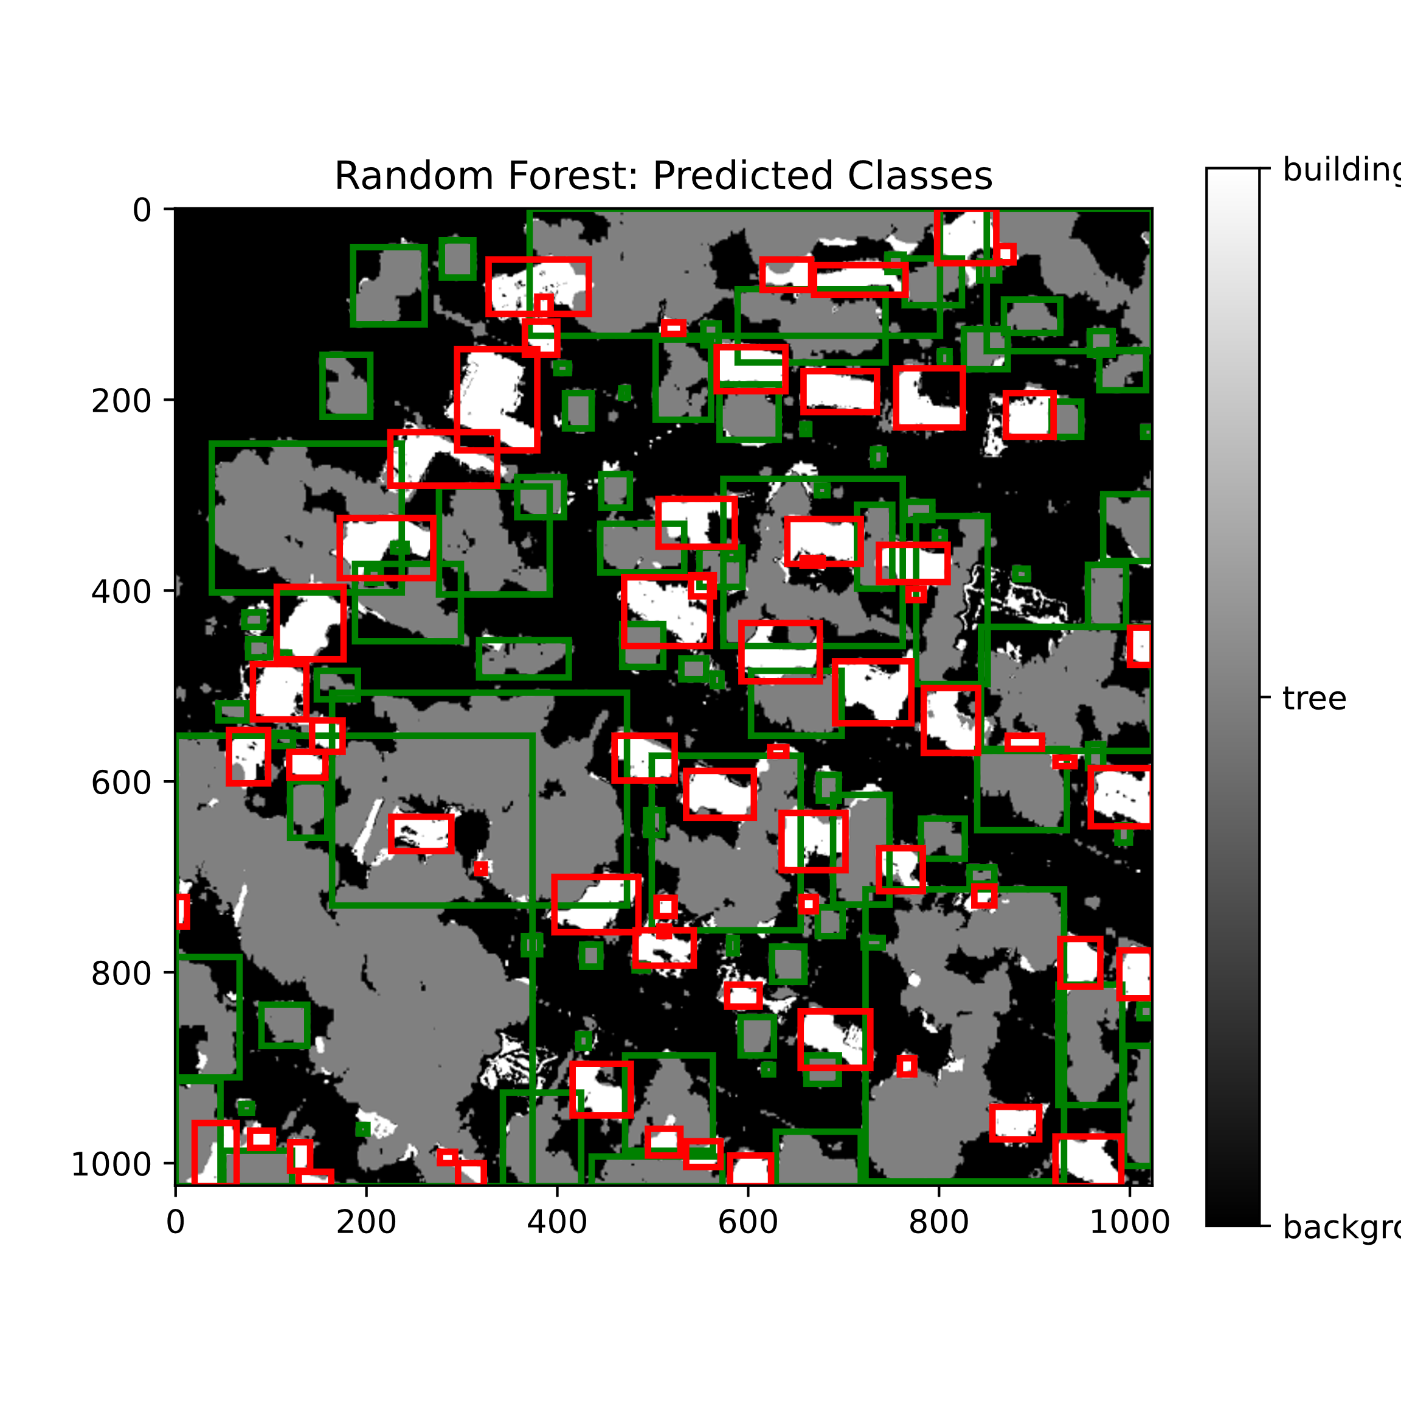
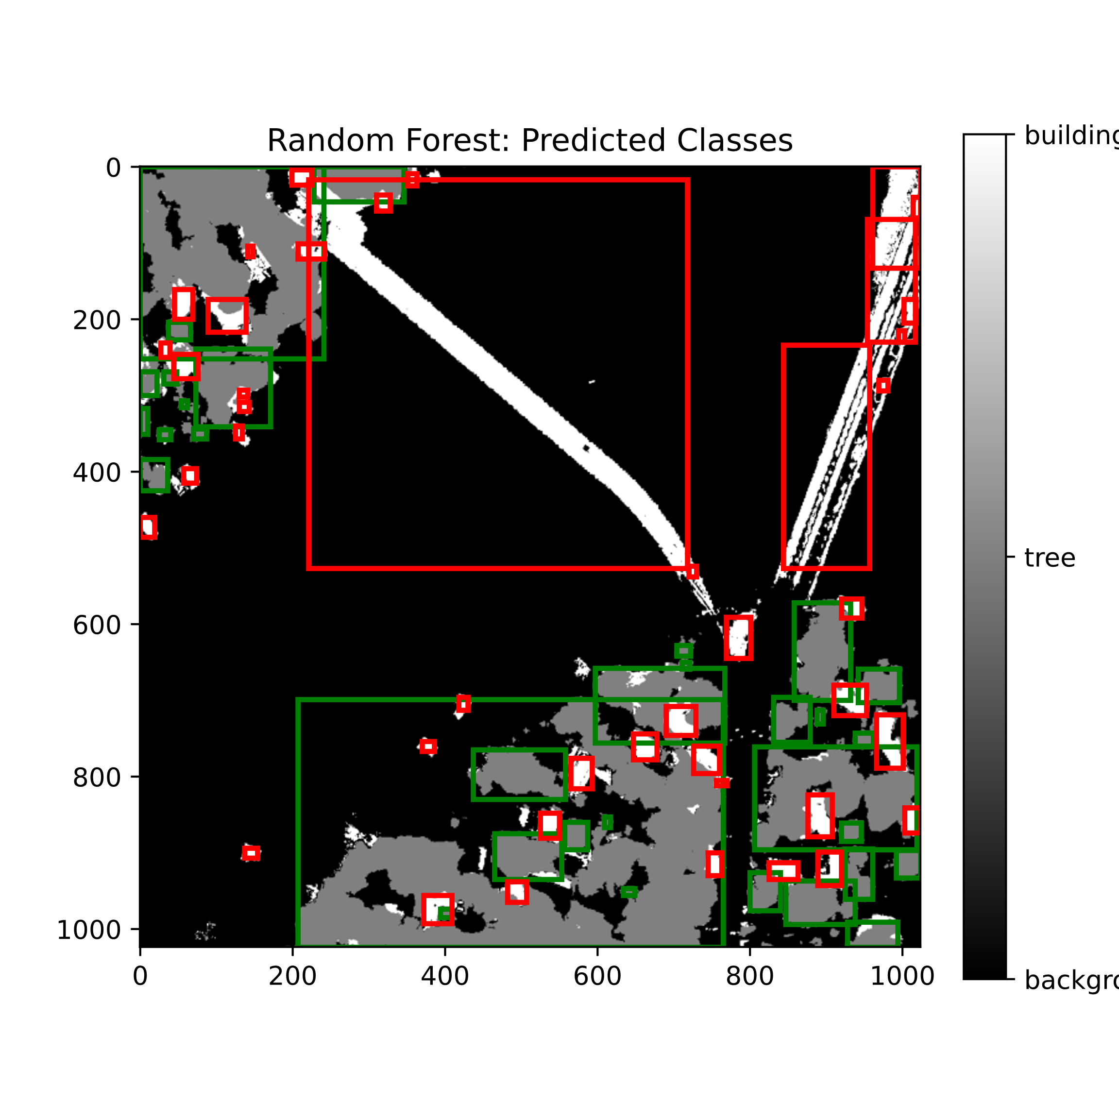
Results: Bounding Boxes

Slide 14
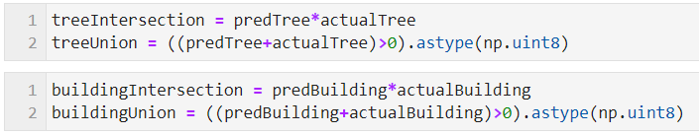
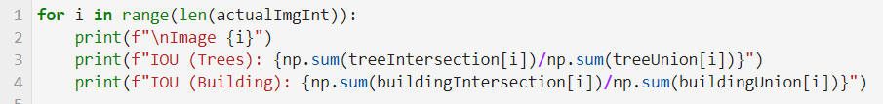
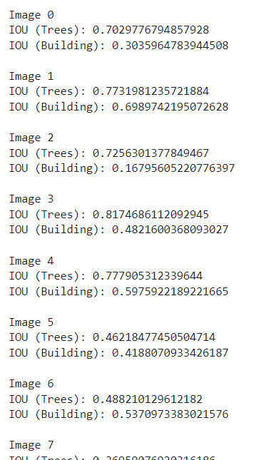
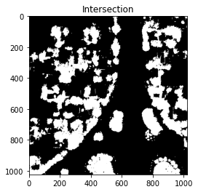
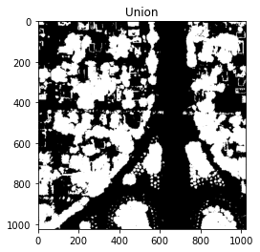
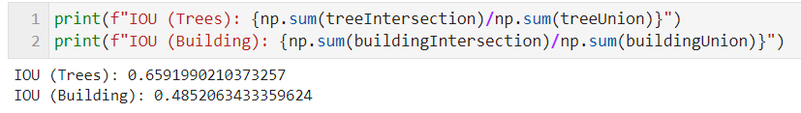
Evaluation: IOU
Intersection area over Union area for every image in validation set
IOU for complete validation dataset

Slide 15

U-Net: Structure
We cropped (256x256) pixel images out of the 31 images of size (1024x1024).
Hence, the training data has 31*16 =-496 images and their corresponding pixel class targets. The images were trained in batches of 8 images.
We followed the encoder-decoder scheme, however, we used different number of filters than this.

Slide 16
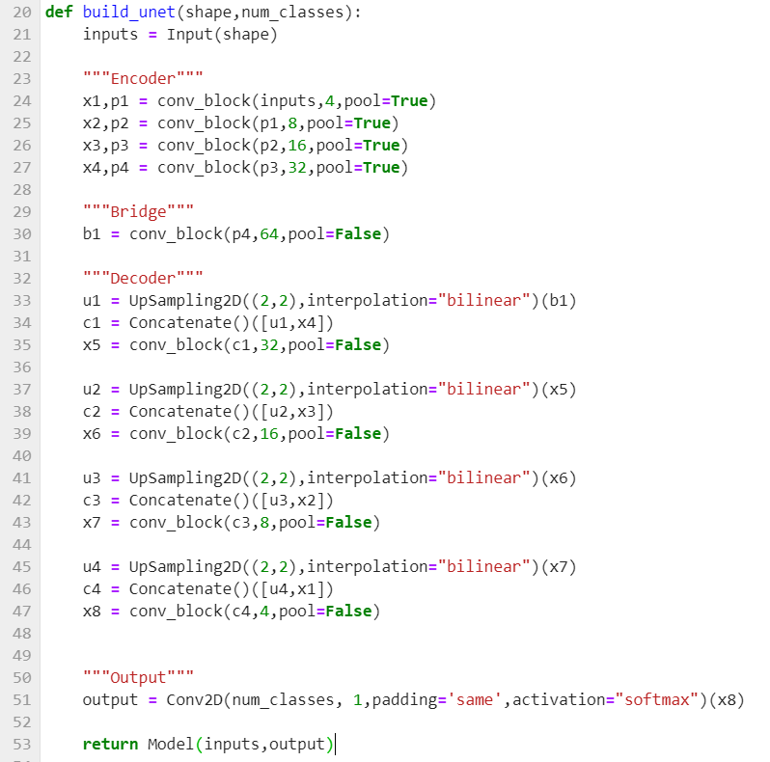
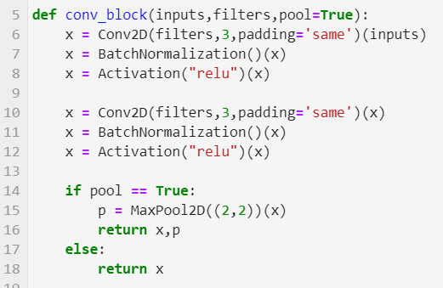
U-Net: Structure
Tensorflow implementation
We cropped (256x256) pixel images out of the 31 images of size (1024x1024).
Hence, the training data has 31*16 =-496 images and their corresponding pixel class targets. The images were trained in batches of 8 images.
We followed the encoder-decoder scheme, however, we used different number of filters than this.

Slide 17
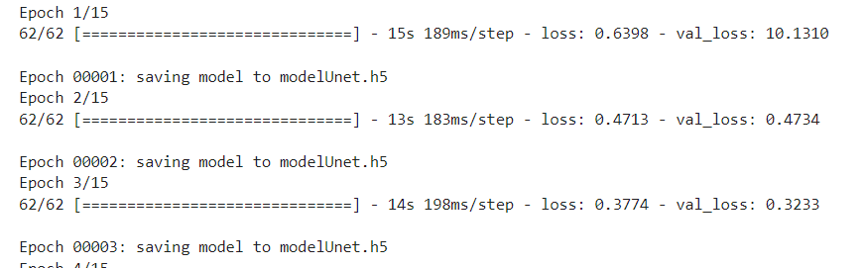
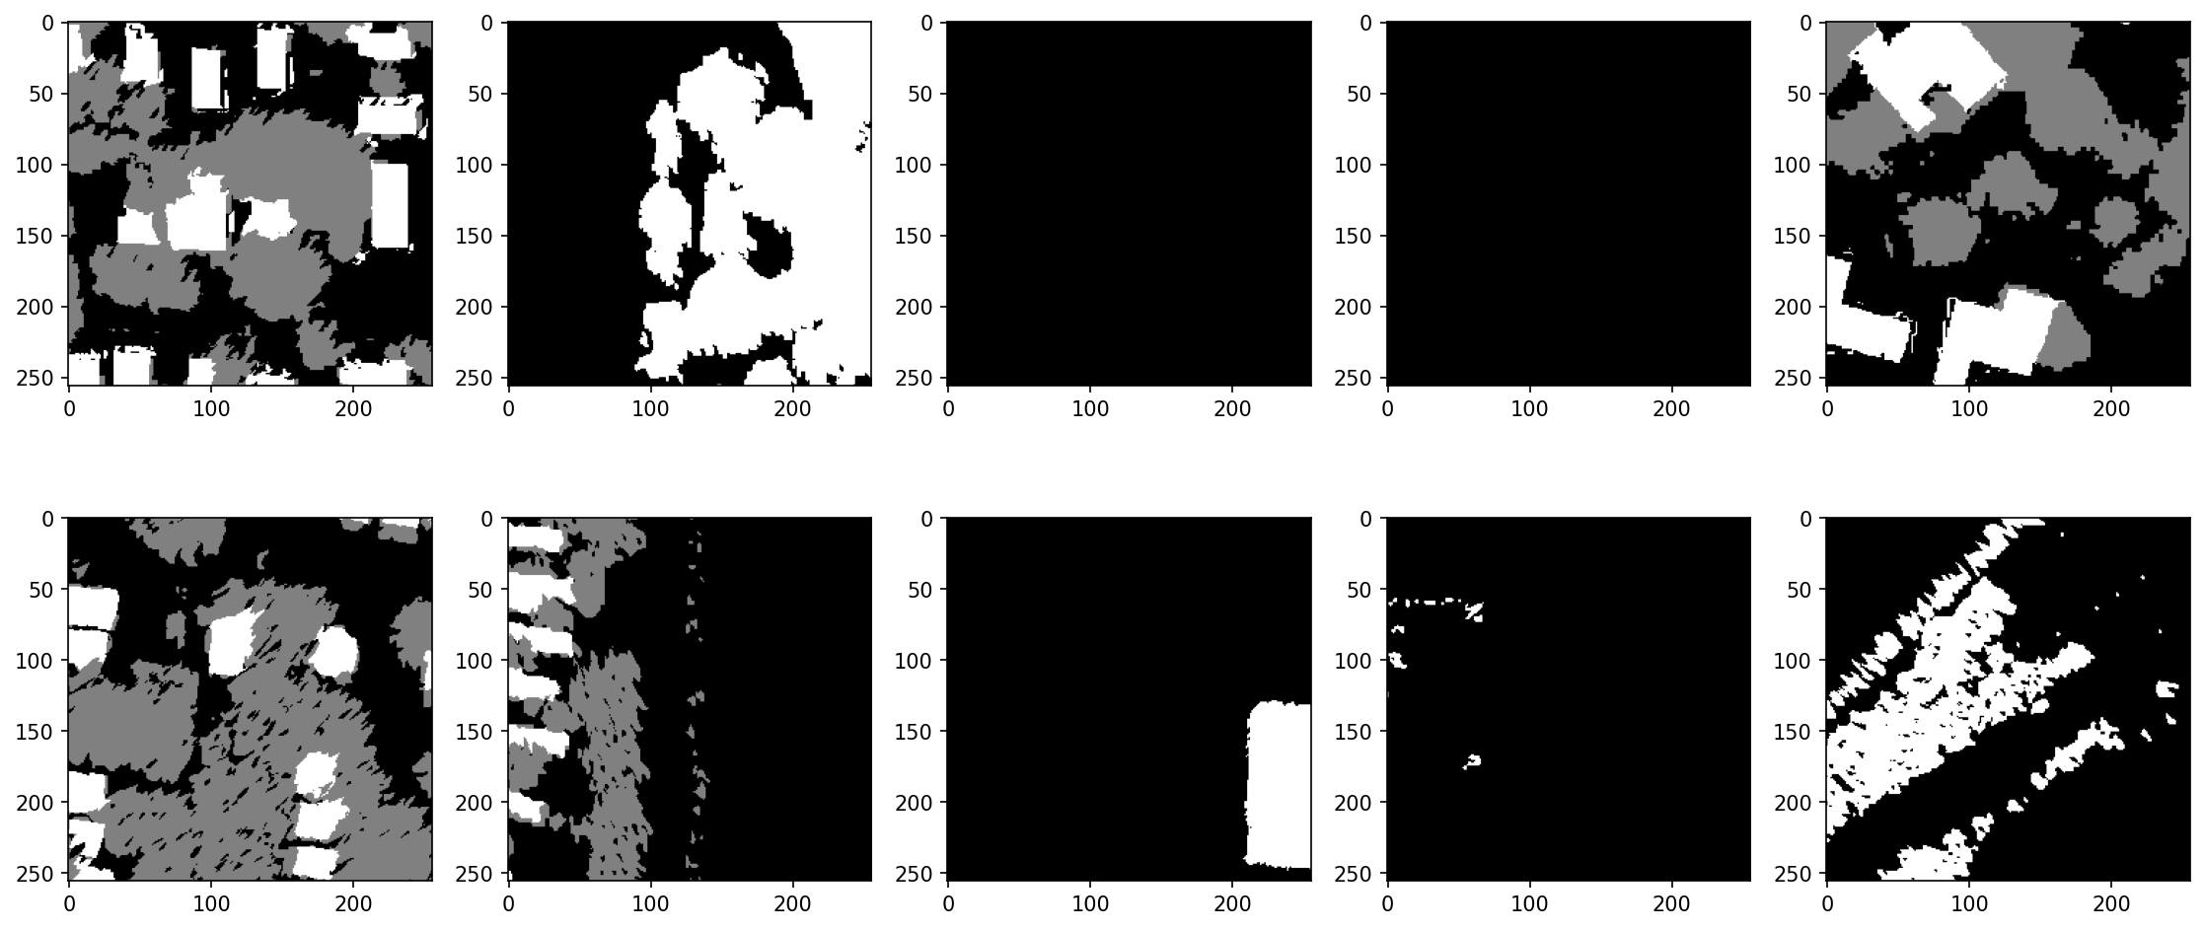
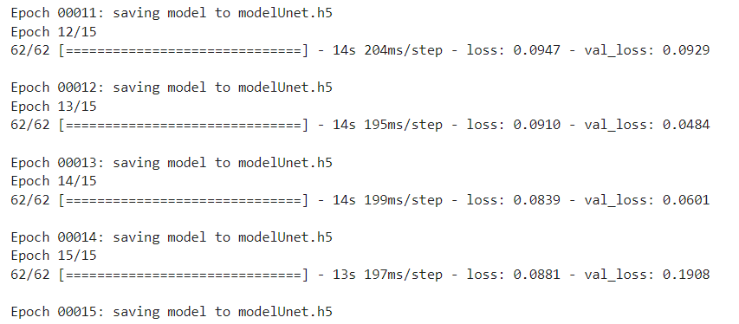
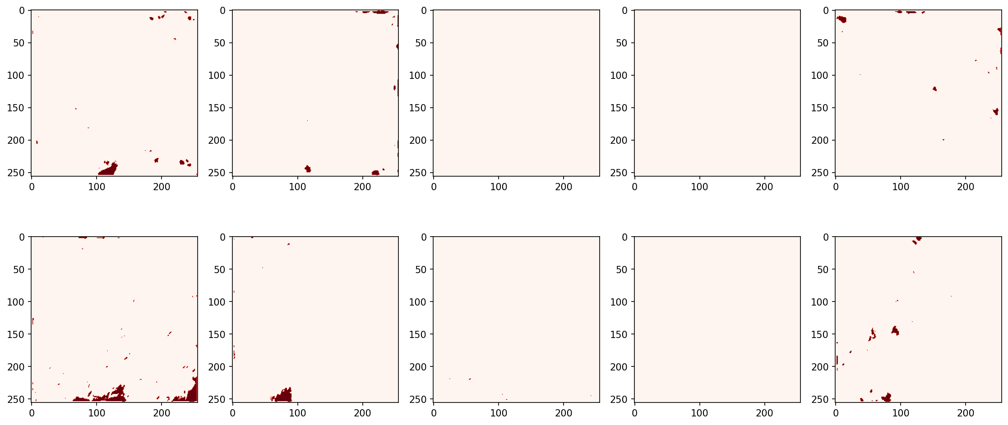
Results: U-Net
Ground Truth
……….
Predictions: This didn’t work as expected.

Slide 18
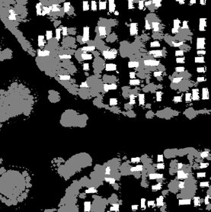
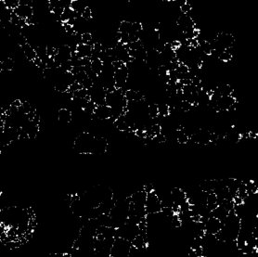
Current Work: Top-hat transform for individual tree detection
Ground Truth
Top-Hat Image of tree

Slide 19
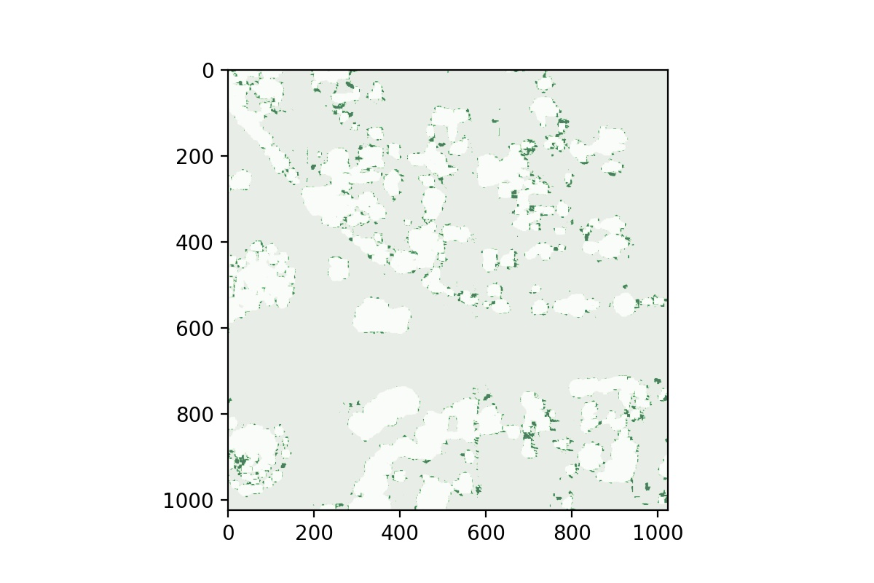
Current Work: Top-hat transform for individual tree detection
Ground Truth Overlapped with Top-hat Image

Slide 20
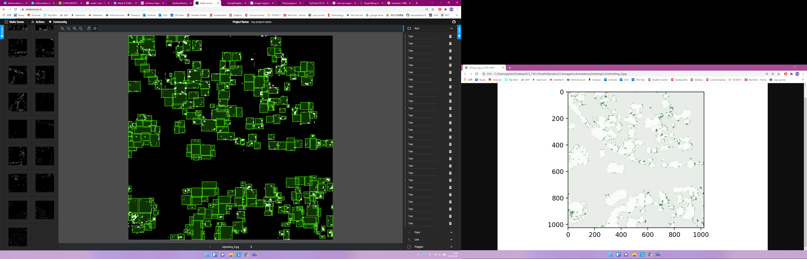
Current Work: Top-hat transform for individual tree detection

Slide 21
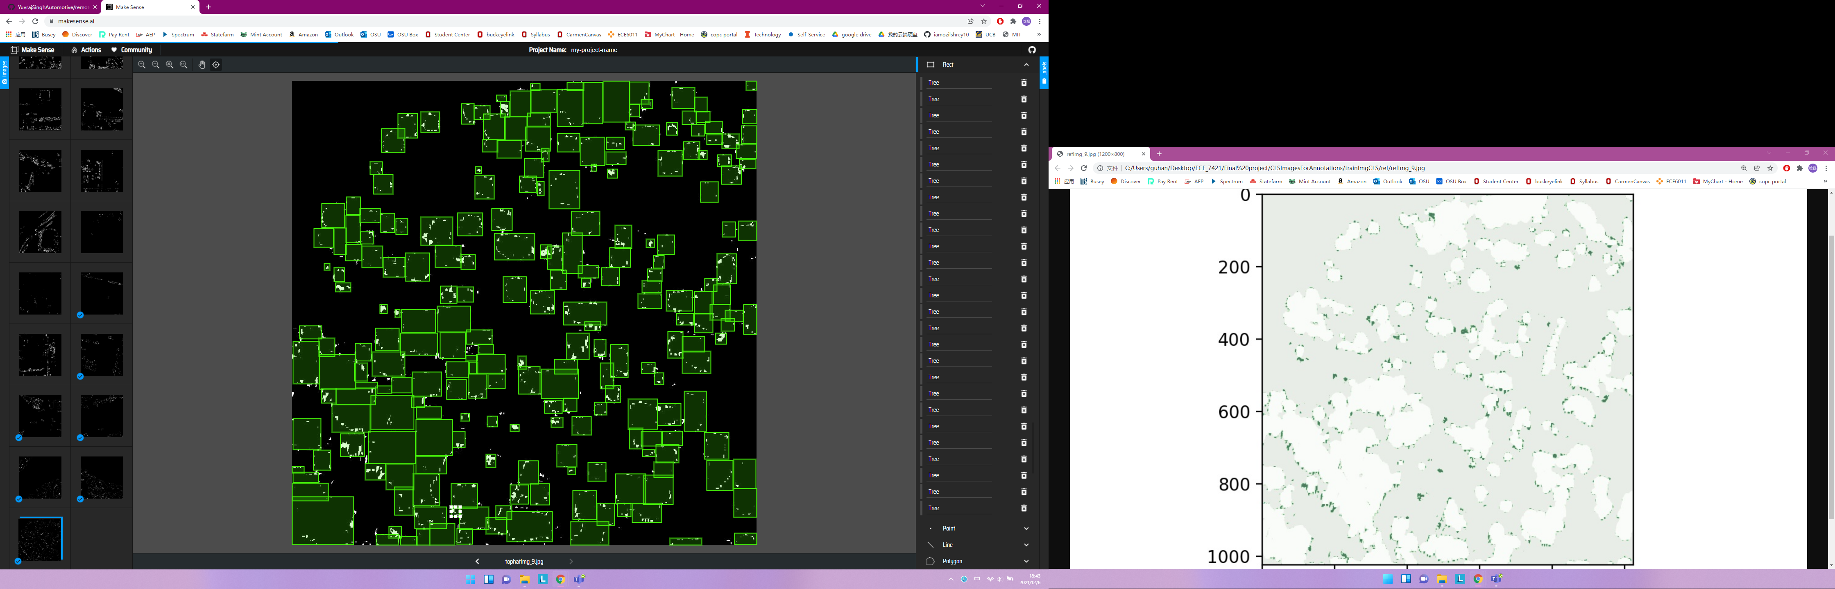
Current Work: Top-hat transform for individual tree detection

Slide 22
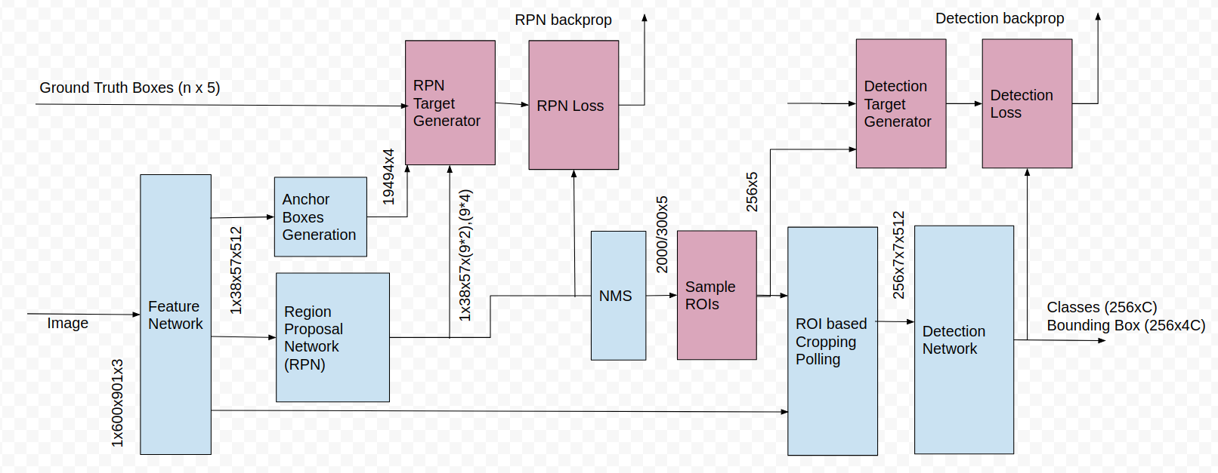
Future Wok: Faster RCNN
General Structure

Slide 23
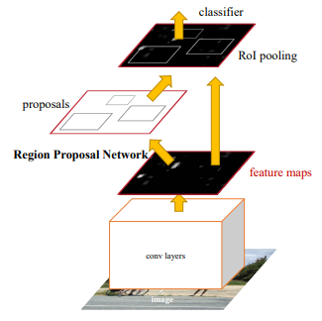
Future Wok: Faster RCNN
Implement our own Feature network, 31 channels,1024*1024 image size

Slide 24
A traditional method for detecting individual building from binary mask
It computed the bounding-boxes from binary mask, in other words, it is from segmentation to instance segmentation.
The basic idea is that for a given pixel, find all other pixels that are "connected" to that pixels and take all these pixels as an object, call it a set. A graph?
Neighbor pixel: The pixels near one pixel.
The definition for "connected" of A and its neighbor B is that they have certain relationship L.
If A and B are "connected", B and C are "connected" , then A and C are "connected".
By changing the definition for relationship, we could do tree detection as well.

Slide 25
How to achieve this? Details
Depth First Search
For a pixel (x ,y), the neighbor pixel is (x-1 ,y) , (x,y+1) , (x+1,y) , ( x,y-1).
A pixel A and its' neighbor B is connected if A and B are both building pixel.
First search "up" (x-1,y), then "right", then " down", then "left".

Slide 26
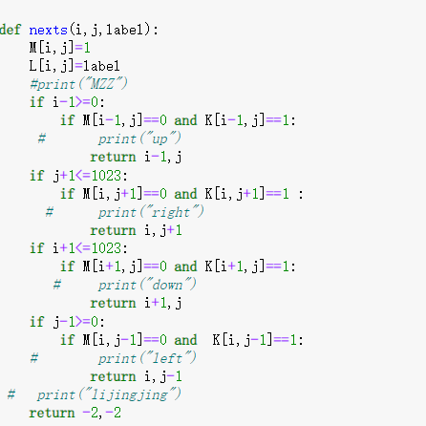

Code:
Serach for the neighbor
Depth first search

Slide 27

Results: Take one image as example
The algorithm would give 379 possible sets. Eliminate the sets that contain pixels less than 5000. All other sets detected as a building. The number is 14. Draw the bounding box.

Slide 28

Result:

Slide 29

For the trees

Slide 30
Some disadvantages about this algorithm:
It could not do real time detection.
It is based on a good segmentation result.
Try deep learning method.

Slide 31
Yolo network: I failed to train a reasonable result.
I used a pre-trained backbone for VOC 2007 dataset.
And used the first three PCA feature of the combination of height and 8-band feature. Hope it works like the RGB feature.
The dataset for training is small, so need to crop the map to get more dataset.
Try to unbalance the confidence of prediction. It doesn't matter if the detected bouding-box not include a building. All the building must have a bounding-box include it.

Slide 32




For each map, do an PCA as a pre-processing.
Random find a sub-image

Slide 33


